Slide 1
Project Cost Management

Slide 2
The Importance of Project Cost Management
IT projects have a poor track record for meeting budget goals
A cost overrun is the additional percentage or dollar amount by which actual costs exceed estimates
A 2011 Harvard Business Review study reported an average cost overrun of 27 percent. The most important finding was the discovery of a large number of gigantic overages or “black swans”

Slide 3
What is Cost and Project Cost Management?
Cost is a resource sacrificed or foregone to achieve a specific objective or something given up in exchange
Costs are usually measured in monetary units like dollars
Project cost management includes the processes required to ensure that the project is completed within an approved budget

Slide 4
Project Cost Management Processes
Planning cost management :determining the policies, procedures, and documentation that will be used for planning, executing, and controlling project cost.
Estimating costs: developing an approximation or estimate of the costs of the resources needed to complete a project
Determining the budget: allocating the overall cost estimate to individual work items to establish a baseline for measuring performance
Controlling costs: controlling changes to the project budget

Slide 5
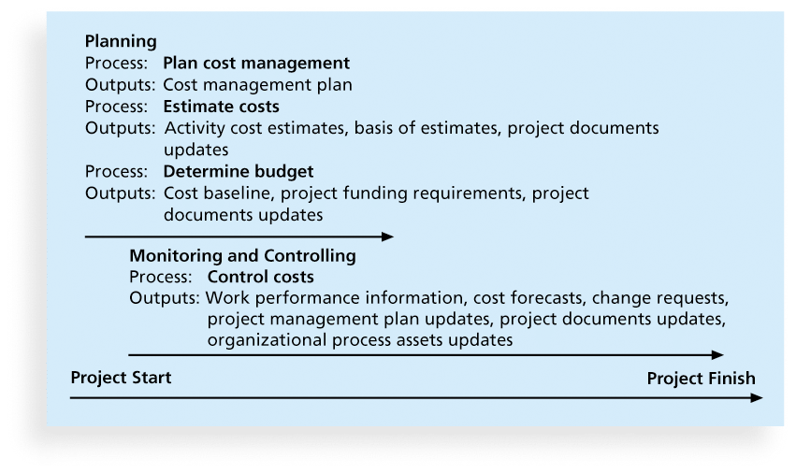
Figure 7-1. Project Cost Management Summary
Planning
Process
Plan cost management
Outputs
Cost management pan
Process
Estimate costs
Outputs
Activity costs estimates
basis of estimates
project documents updates
Process
Determine budget
Outputs
Cost baseline
Project funding requirements
Project documents updates
Monitoring and Controlling
Process
Control costs
Outputs
Work performance information
Cost forecasts
Change requests
Project management plan updates
Project documents updates
Organizational process assets updates
Project Finish

Slide 6
Types of Costs and Benefits
Tangible costs or benefits are those costs or benefits that an organization can easily measure in dollars
Intangible costs or benefits are costs or benefits that are difficult to measure in monetary terms
Direct costs are costs that can be directly related to producing the products and services of the project
Indirect costs are costs that are not directly related to the products or services of the project, but are indirectly related to performing the project
Sunk cost is money that has been spent in the past; when deciding what projects to invest in or continue, you should not include sunk costs

Slide 7
More Basic Principles of Cost Management
Learning curve theory states that when many items are produced repetitively, the unit cost of those items decreases in a regular pattern as more units are produced
Reserves are dollars included in a cost estimate to mitigate cost risk by allowing for future situations that are difficult to predict
Contingency reserves allow for future situations that may be partially planned for (sometimes called known unknowns) and are included in the project cost baseline
Management reserves allow for future situations that are unpredictable (sometimes called unknown unknowns

Slide 8
Planning Cost Management
The project team uses expert judgment, analytical techniques, and meetings to develop the cost management plan
A cost management plan includes:
Level of accuracy and units of measure
Organizational procedure links
Control thresholds
Rules of performance measurement
Reporting formats
Process descriptions

Slide 9
Estimating Costs
Project managers must take cost estimates seriously if they want to complete projects within budget constraints
It’s important to know the types of cost estimates, how to prepare cost estimates, and typical problems associated with IT cost estimates

Slide 10
Table 7-1. Types of Cost Estimates
TYPE OF ESTIMATE | WHEN DONE | WHY DON’T | HOW ACCURATE
Rough order of magnitude (ROM) | Very early in the project life cycle. | Provides estimate of cost for selection decisions | -50% to +100%
Budgetary | During project planning or when scope is clearer | Puts dollars in the budget plans | -10% to +25%
Definitive | Once project design and scope are well defined (execution planning phase) | Provides details for purchases, estimates actual costs | -5% to+10%

Slide 11
Cost Estimation Tools and Techniques
Basic tools and techniques for cost estimates:
Analogous or top-down estimates: use the actual cost of a previous, similar project as the basis for estimating the cost of the current project
Bottom-up estimates: involve estimating individual work items or activities and summing them to get a project total
Parametric modeling uses project characteristics (parameters) in a mathematical model to estimate project costs

Slide 12
Typical Problems with IT Cost Estimates
Estimates are done too quickly
People lack estimating experience
Human beings are biased toward underestimation
Management desires accuracy

Slide 13
Sample Cost Estimate
See the text for a detailed example of creating a cost estimate for the Surveyor Pro project described in the opening case
Before creating an estimate, know what it will be used for, gather as much information as possible, and clarify the ground rules and assumptions for the estimate
If possible, estimate costs by major WBS categories
Create a cost model to make it easy to make changes to and document the estimate

Slide 14
Figure 7-2. Surveyor Pro Project Cost Estimate
Surveyor Pro Project Cost Estimate October 5
Empty cell | # Units/Hrs. | Cost/Unit/Hr. | Subtotals | WBS Level 2 Totals | % of Total
WBS Items | Empty cell | Empty cell | Empty cell | Empty cell | Empty cell
1. Project Management | Empty cell | Empty cell | Empty cell | $306,300 | 20%
Project manager | 960 | $100 | $96,000 | Empty cell | Empty cell
Project team members | 1920 | $75 | $144,000 | Empty cell | Empty cell
Contractors (10% of software development and testing) | Empty cell | Empty cell | $66,300 | Empty cell | Empty cell
2. Hardware | Empty cell | Empty cell | Empty cell | $76,000 | 5%
2.1 Handheld devices | 100 | $600 | $60,000 | Empty cell | Empty cell
2.2 Servers | 4 | $4,000 | $16,000 | Empty cell | Empty cell
3. Software | Empty cell | Empty cell | Empty cell | $614,000 | 40%
3.1 Licensed software | 100 | $200 | $20,000 | Empty cell | Empty cell
3.2 Software development* | Empty cell | Empty cell | $594,000 | Empty cell | Empty cell
4. Testing (10% of total hardware and software costs) | Empty cell | Empty cell | $69,000 | $69,000 | 5%
5. Training and Support | Empty cell | Empty cell | Empty cell | $202,400 | 13%
Trainee cost | 100 | $500 | $50,000 | Empty cell | Empty cell
Travel cost | 12 | $700 | $8,400 | Empty cell | Empty cell
Project team members | 1920 | $75 | $144,000 | Empty cell | Empty cell
6. Reserves (20% of total estimate) | Empty cell | Empty cell | $253,540 | $253,540 | 17%
Total project cost estimate | Empty cell | Empty cell | Empty cell | $1,521,240 | Empty cell
*See software development estimate

Slide 15
Figure 7-3. Surveyor Pro Software Development Estimate
1. Labor Estimate | # Units/Hrs. | Cost/Unit/Hr. | Subtotals | Calculations
Contractor labor estimate | 3000 | $150 | $450,000 | 3000*150
Project team member estimate | 1920 | $75 | $144,000 | 1920*75
Total labor estimate | Empty cell | Empty cell | $594,000 | Sum above two values
Empty cell | Empty cell | Empty cell | Empty cell | Empty cell
2. Function point estimate | Quantity | Conversion Factor | Function Points | Calculations
External inputs | 10 | 4 | 40 | 10*4
External interface files | 3 | 7 | 21 | 3*7
External outputs | 4 | 5 | 20 | 4*5
External queries | 6 | 4 | 24 | 6*4
Logical internal tables | 7 | 10 | 70 | 7*10
Total function points | Empty cell | Empty cell | 175 | Sum above function point values
Java 2 language equivalency value | Empty cell | Empty cell | 46 | Assumed value from reference
Source lines of code (SLOC) estimate | Empty cell | Empty cell | 8,050 | 175*46
ProductivityxKSLOC^Penalty (in months) | Empty cell | Empty cell | 29.28 | 3.13*8.05^1.072 (see reference)
Total labor hours (27 hours/function point)* | Empty cell | Empty cell | 4,725 | 27*175
Cost/labor hour ($120/hour) | Empty cell | Empty cell | $120 | Assumed value from budget expert
Total function point estimate | Empty cell | Empty cell | $567.000 | 4,725*120
*Based on historical data
© Cengage Learning 2016

Slide 16
Determining the Budget
Cost budgeting involves allocating the project cost estimate to individual work items over time
The WBS is a required input to the cost budgeting process since it defines the work items
Important goal is to produce a cost baseline
a time-phased budget that project managers use to measure and monitor cost performance

Slide 17
Controlling Costs
Project cost control includes
Monitoring cost performance
Ensuring that only appropriate project changes are included in a revised cost baseline
Informing project stakeholders of authorized changes to the project that will affect costs
Many organizations around the globe have problems with cost control

Slide 18
Project Portfolio Management
Many organizations collect and control an entire suite of projects or investments as one set of interrelated activities in a portfolio
Five levels for project portfolio management
Put all your projects in one database
Prioritize the projects in your database
Divide your projects into two or three budgets based on type of investment
Automate the repository
Apply modern portfolio theory, including risk-return tools that map project risk on a curve

Slide 19
Summary
Project cost management is a traditionally weak area of IT projects, and project managers must work to improve their ability to deliver projects within approved budgets
Main processes include
Plan cost management
Estimate costs
Determine the budget
Control costs

